Slide 1
Improving transparency and accountability in New Mexico’s lobbying practices
Lara Miller
April 20, 2022

Slide 2
Using NLP to help shine a light on lobbyist influence
New Mexico is one of fifteen states that has minimal disclosure rules for lobbyists. It only requires a lobbyist to register themselves and their clients, and report basic spending and candidate contributions each session . It does not require reporting of their compensation or reporting on which bills they had been hired to support, oppose, or otherwise worked
My client is the public - identifying the efforts of paid lobbyists to influence public policy will increase public confidence in the integrity of legislative process

Slide 3
Data (2013 to 2020)
List of bills acted on by governor
Bill ID, Bill Title, Action by Governor, Bill Sponsor (1,480)
Bill Texts
Pdfs of bills enacted (1,450)
Avg word length = 5,428
Avg page length = 2 pages
List of lobbyists
Registered lobbyists, business information, employers by year (12k)
Campaign donations from lobbyists to legislators
Lobbyist, donation ($), legislator or campaign of donation (25k)

Slide 4
NLP Process
Data collection
1
Topic Modeling of bill text
2
Gensim – LDA
Sumy - Summarize texts
Topic Modeling of lobbyists
3
Tableau Dashboard
4
Create dashboard highlighting lobbyist influence by topic
Scrape all pdfs of bills and convert to text files
Scrape list of bills
NMF -TFIDF
Download lobbyist spreadsheets
Create corpus
Tools: selenium, pdfplumber, pdfminer
Tools: pandas, nltk, spacy, sumy, gensim
Tools: nltk, TFIDF, NMF
Tools: tableau

Slide 5
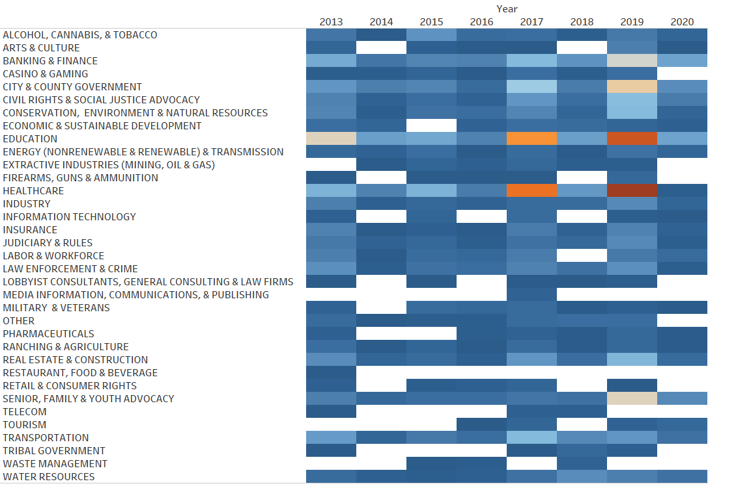
NLP Results
38 Topics

Slide 6
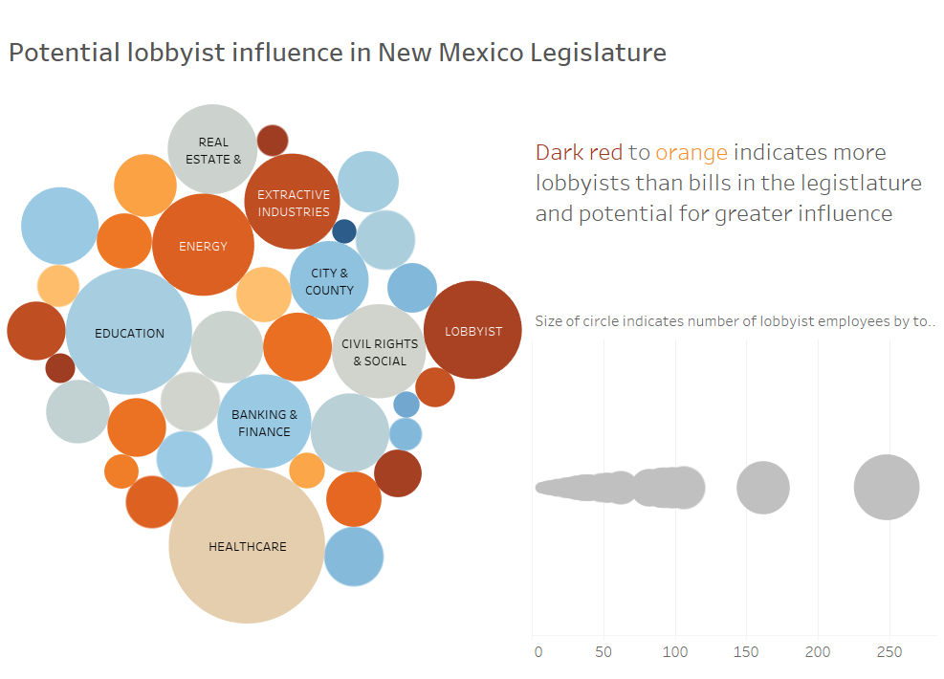
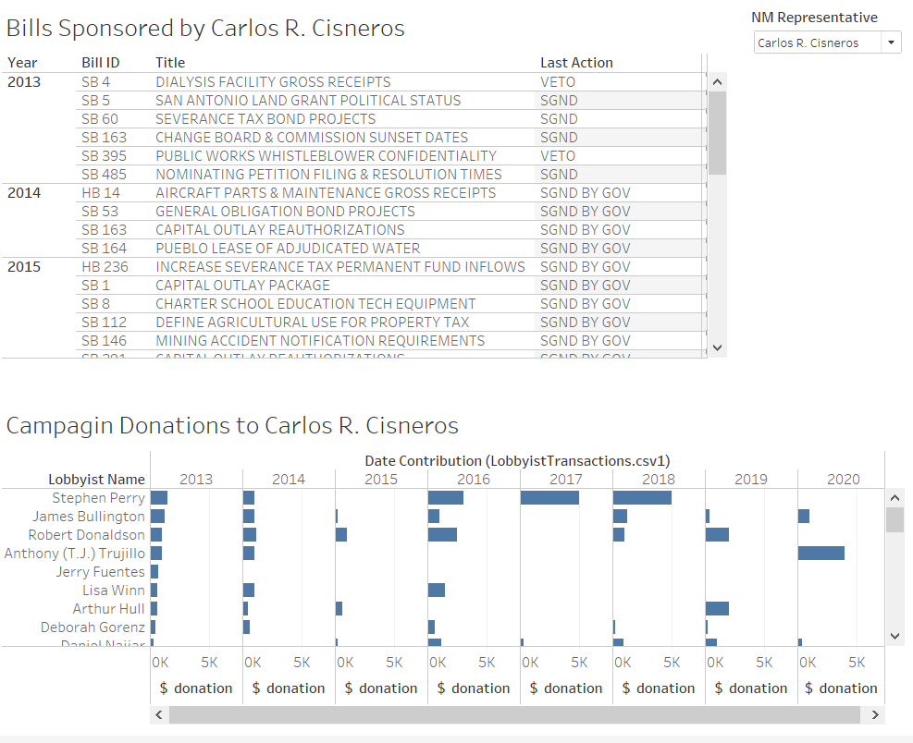
Final Product
Tableau dashboard

Slide 7
Future Work
Additional text preprocessing and categorization of bills for bill summarization to improve topic modeling
Change topic modeling of lobbyist employer

